Slide 1

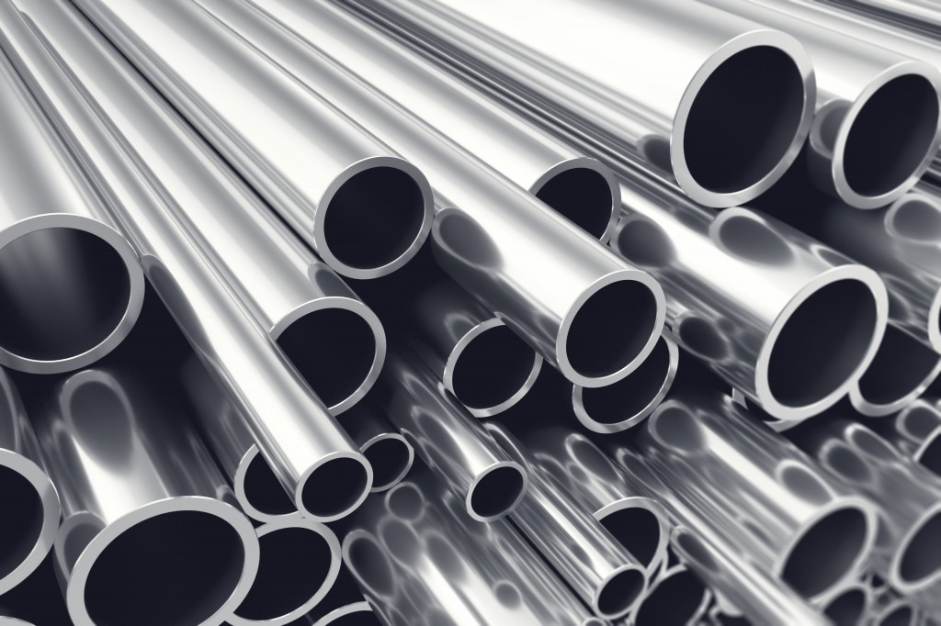
STEEL INDUSTRY IN KEY MARKETS(2022)
This presentation(till slide 5), explores the current landscape of the global steel industry in 2022. Our qualitative research aims to uncover trends, challenges, and opportunities across key markets. Let's dive into the findings and gain a comprehensive understanding of this dynamic industry.

Slide 2
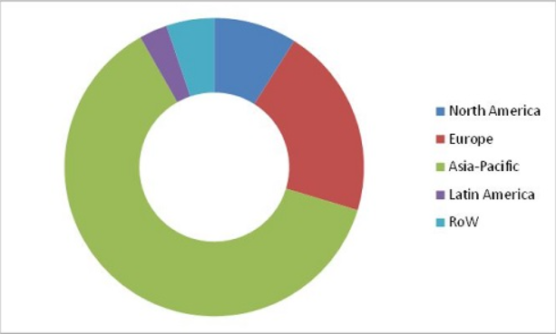
Key Markets
In 2022, the global steel market was worth about USD 1.27 trillion. It's expected to grow at a CAGR of 4% from 2023–2028, reaching around USD 1.61 trillion by 2028.
The global steel market is divided into 5 regions:
North America
Latin America
Asia Pacific
Europe
Middle East & Africa
In 2022, the Asia Pacific region accounted for over 59% of the global market share.
Steel Industry Insights 2022

Slide 3
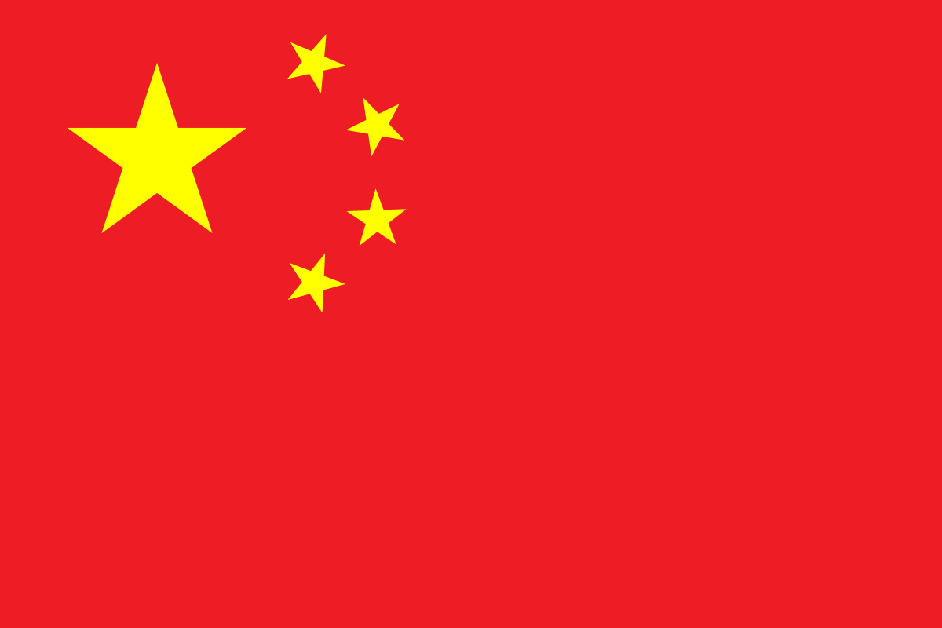

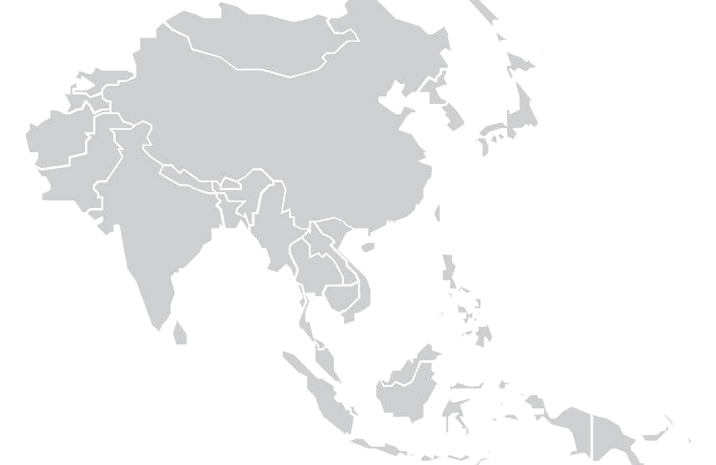

Top Consumers
China- World’s largest steel consumer(2022). Consumed 51.7% of world’s steel. Here, 55% steel is used in construction & 20% in machinery.
India- Second largest steel consumer(2022). Consumed approx. 6% of world’s steel. Here, also maximum steel is used in construction.
Rest of Asia consumed 14.5% of the world’s steel. Maximum of these steels is used up in construction.
EU consumed 16.6% of the world’s steel. Construction, automotive, & machinery are key industries.
This Photo by Unknown Author is licensed under CC BY-SA

Slide 4
Revenue Share By Region
Region | Market Value(2022) | Revenue Forecast | CAGR
North America | USD 9.70 Billion | USD 13.99 Billion | 4.8%(2022-2030)
Latin America | USD 16.13 Billion | USD 26.57 Billion | 5.2%(2023-2031)
Europe | USD 132 Billion | USD 99.4 Billion | -3.03%(2022-2026)
Asia Pacific | USD 1258 Billion | USD 1723 Billion | 4.6%(2023-2029)
Middle East & Africa | USD 27.6 Billion | USD 44.4 Billion | 5.0%(2023-2031)

Slide 5
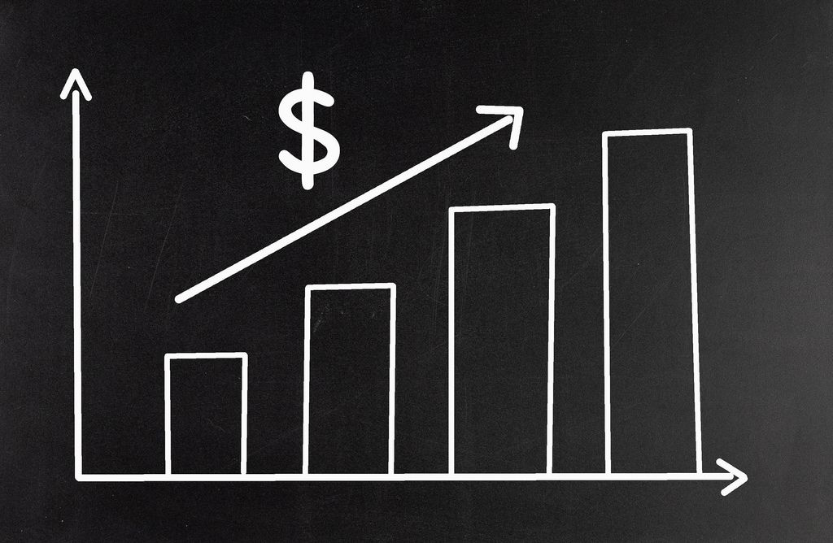
Future
The global steel market was valued at USD 1.27 trillion in 2022 & USD 1.27 trillion in 2023.
The global steel market is expected to grow significantly between 2023 and 2030. Steel demand is projected to increase by 30% by 2050, with most regions, including India, Africa, and South-East Asia, seeing an increase in demand.
It's expected to grow at a CAGR of 4% between 2024 and 2032, reaching around USD 1.61 trillion by 2032.
The global steel market is expected to grow to 2.3 billion metric tons by 2030, growing at a CAGR of 3% between 2022 and 2030.
Global demand for low-CO2 steel is expected to grow tenfold over the next decade, from approximately 15 million metric tons in 2021 to more than 200 million metric tons by 2030.

Slide 6
SteelCo. Ltd Insights
From here, we delve into the data-driven insights generated through rigorous analysis. Our goal is to uncover valuable conclusions and recommendations based on a comprehensive evaluation of SteelCo. Ltd.'s financial performance in 2022. This data-driven exploration serves as a crucial tool for enhancing profitability and making informed strategic decisions.

Slide 7
SteelCo. Key Markets
Revenue Share
In 2022, the overall revenue was about USD 1.17 Billion(converted to USD using 1 Euro = 1.0538 USD, average 2022 conversion rate.)
The SteelCo's markets are:
EMEA(Europe, Middle East & Africa)
North America
Asia Pacific
South America
In 2022, the EMEA region accounted for around 50% of the total share in terms of revenue.
EMEA
Others
SteelCo. Insights 2022

Slide 8




SteelCo’s Top Consumers
USA is the top contributor in the revenue & 2nd in volume.
Finland is 2nd in contribution to revenue and 1st in volume.
Canada is the 3rd highest contributor to revenue and 5th in volume.
Sweden is 4th in terms of revenue contribution as well as volume.

Slide 9

Key Insights
EMEA region is the highest contributor in terms of revenue(50%), gross margin(50%), & volume(59%).
Top 3 countries in terms of revenue are USA, Finland, & Canada. And in terms of volume are Finland, USA, & Uruguay.
If we look at product type we find that CORE & THERMA combined generated 58% in revenue and were 87% of the total volume of products.
CORE & THERMA also have high margins of 31% and 26% respectively.

Slide 10
Recommendations
Focus on EMEA Market: Prioritize and expand in the EMEA region, which is a key revenue and volume contributor. Invest in targeted marketing & sales strategies to expand company’s presence.
Expand in High-Growth Regions: Seize opportunities in high-growth markets, particularly in the Asia Pacific region.
Improve Sustainability: Invest in carbon-reduction technologies to meet low-CO2 steel demand.
Strengthen Customer Relationships: Maintain strong connections with top revenue-generating countries, like the USA, Finland, Canada, Sweden, and Germany.
Cost Optimization: Evaluate cost optimization strategies for products with lower margins.
Monitor Market Trends: Stay vigilant in monitoring global steel market trends and consumer preferences.
Prepare for Increased Demand: Get ready for higher production volumes to meet the projected 30% increase in global steel demand by 2050.
Invest in Research and Development: Innovate and produce more environmentally friendly steel products to meet the growing demand for low-CO2 steel.
Supply Chain Optimization: Optimize the supply chain for efficiency and cost-effectiveness.

